Slide 1
AF subtraction

Slide 2
Order of operation issue
In the past I subtracted and then did a dark frame subtraction. This made me believe that it was not a good process. It was patchy and created these really diffuse emitting structures. It was like a huge convolution.
I believe the main issue was the subtraction caused artificial dips. Normally this is not an issue, but it interferes with the main operation of dark frame generation, ie find the lowest pixel in the region and interpolate from there.
Order revised to FF correction, exp time scaling on bleached image (with 10% taken to force to be a lower bound due to exp time extrapolation errors), DF subtraction on each individually, then flat subtraction from each other.

Slide 3
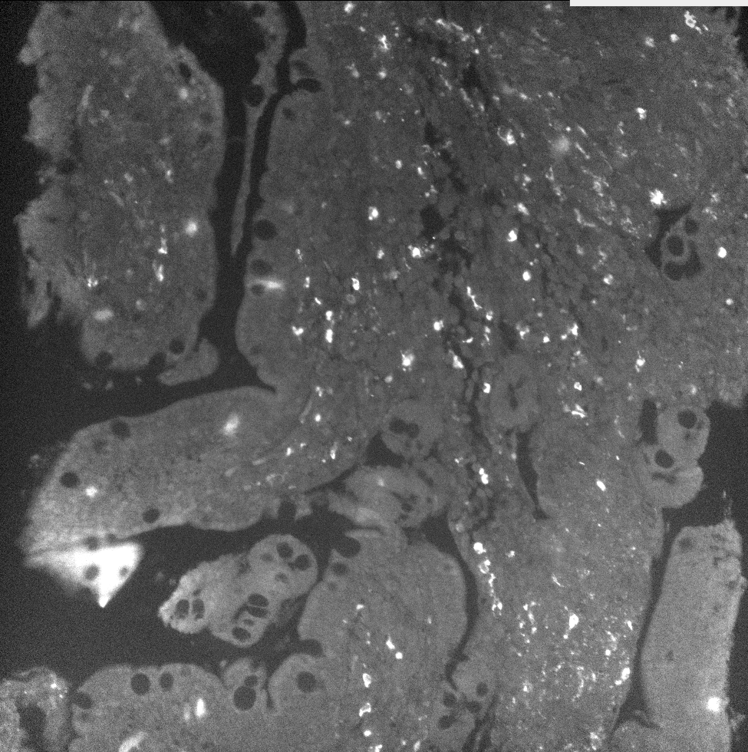
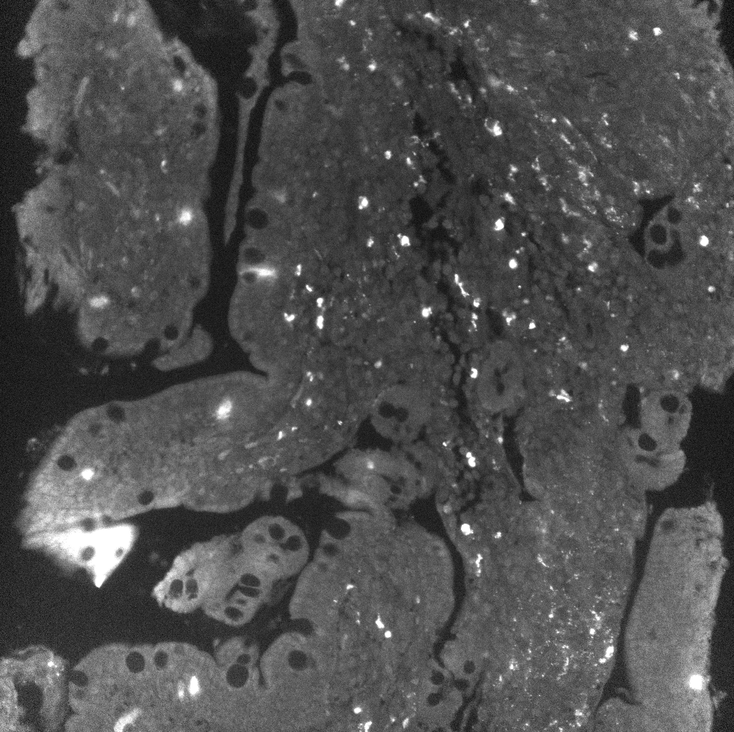
Examples
FF stain cy2
FF bleach after cy1
Hard to tell what is what. A488 channel has many bright cells. Lets look at merges to emphasize

Slide 4
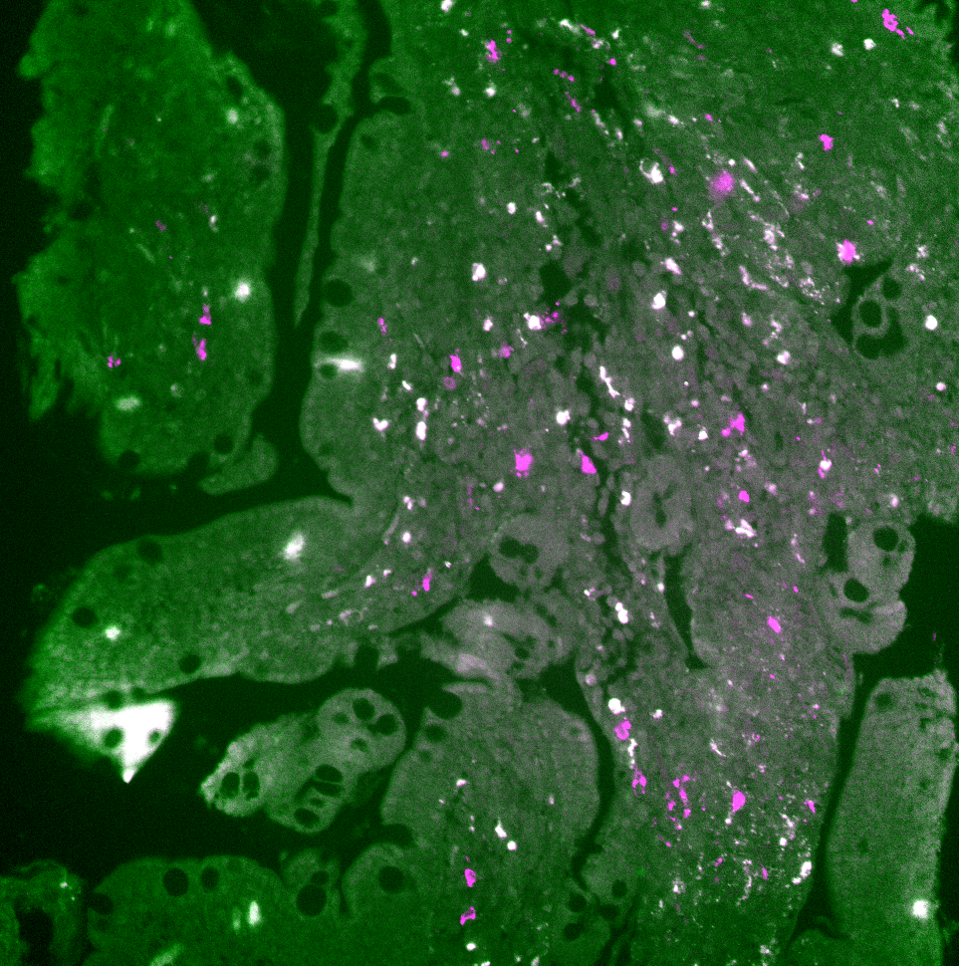
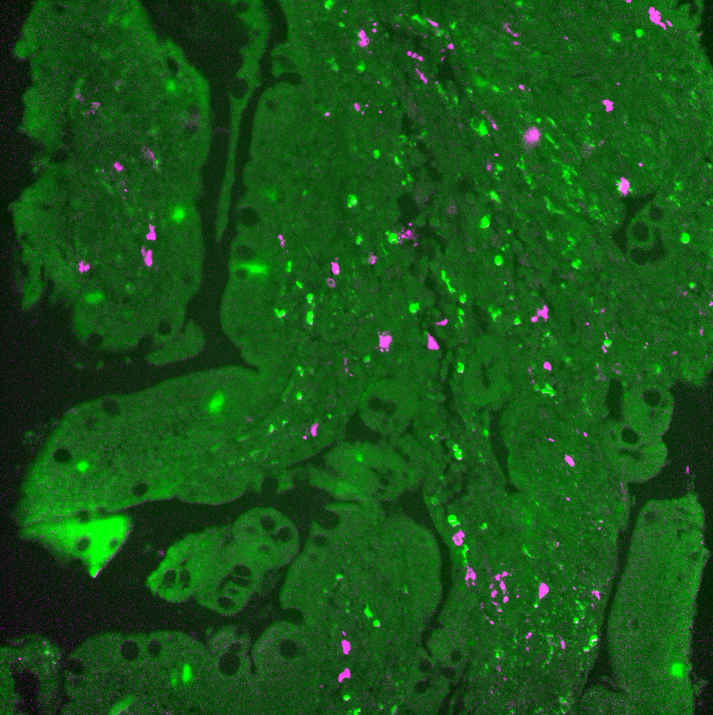
Merged differences
Green = AF
Magenta = Stain
White = magenta + green colocalize
Notice in the merged unsubtracted images that a large amount of white exists.
In the merger of the subtracted stained image with AF, virtually no white exists. Meaning AF has ben successfully suppressed to a sufficient degree.
Merge of stain and AF
Merge of AF subbed stain and AF

Slide 5
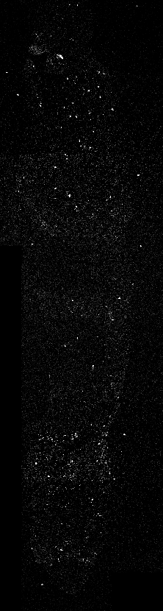
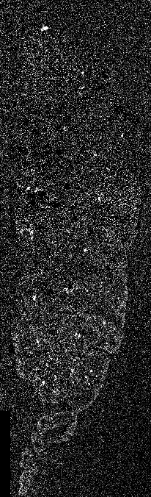
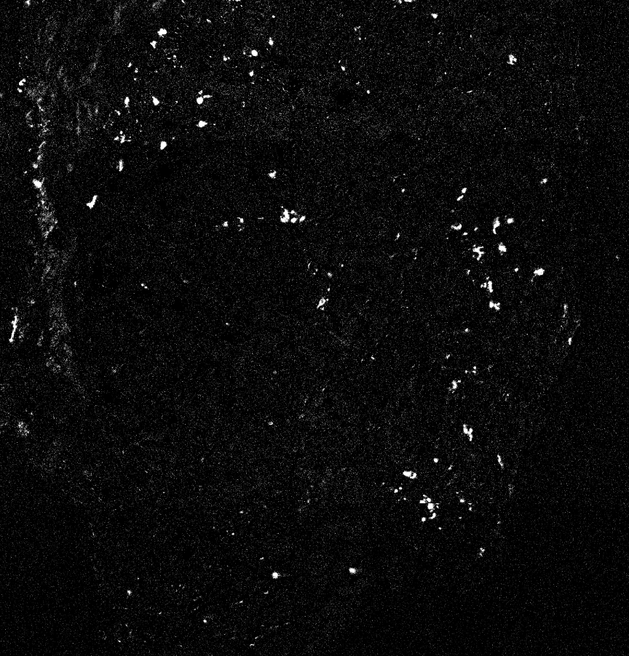
Eveness
Given the DF subbing is individual and subbing after it, it may cause tile to tile brightness unevenness. Lets check
Brightness matching between tiles is very good in this instance!

Slide 6
Suppression of very strong left over patterns
Unfortunately, some stains have proven to be very difficult to bleach. This leads to phantom artifacts being transmitted to the next cycle.
One such stain is SMA. And its phantom with PCNA is very significant

Slide 7
Second Order Dynamic Suppression
Above was a first order suppression. We assumed everything had zero noise and extrapolated and subtracted accordingly.
To achieve 2nd order suppression, we need two components
Register images to remove around 1-5 pixel sifts from images
Dynamically alter AF intensities as a function of XY space in such a way that they better approach the true AF signal that exists in that XY location
Turbo stack reg via pystsackreg package will be used for the first task
Second task needs a tool to evaluate subtraction quality with. What this tool is, is not obvious.
In addition, the goal cannot be absolute subtract as stain may exist on bright AF cells.

Slide 8
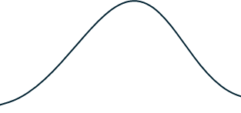
Evaluation Tool
Line profile
AF
Above zero value
-C *
Scaled bleach image
A proper selection of C will produce a straight line
=

Slide 9
Tool ID
In the previous slide, we went from a hill on a line to a straight line. So we need an evaluation metric that can relatively quantify that.
The line is not centered on zero either. Its very difficult to determine the center line via machine vision and any attempt on that was abandoned
There is no known ‘real’ data image as well. We want to generate that. In effect since we do not know the answer, we cannot compare the deviation for the loss function
The non zero line centering throws out of the window the idea of using a deviation from 0 loss function as well
At its heart, we went from a hill to a flat line. Thus a good loss function is summing up the area remaining under the curve. The lower the better. The area under the curve is the local derivative multiplied by the area its applied over. Thus if we broke the image down into a large amount of smaller area (super pixels) and found the derivative there, it would be proportional to the integral loss function (as the suer pixel is the area and fixed relatively with all super pixels).
A metric with a 1st order derivative magnitude at its heart is thus a good loss function for this subtraction event. This points to using the brenner score focus scoring metric as the loss function.

Slide 10
Execution of Mass Brenner Scores?
While Brenner scores of super pixels makes sense, its computationally vert intensive.
Thus to realistically implement it, a more logical approach needs to be leveraged.
While no python package has a prebuilt function for this, the dark frame subtraction function contains a function I built that breaks up an image into a series of uniformly sized super pixels by altering strides in memory space. This approach is extremely fast in comparison to looped versions.
If I extend this from 2D to 3D space, I can make brenner filtered super pixels and alter the C constant multiplier value as a function of the 3rd dimension (technically this is 5 dimensions as the first two are super pixels). Just like in dark frame subtraction, I can rapidly collapse the 2D array of the super pixels to get the total brenner score in each super pixel and then I am left with a 3D array where each 2D pixel is a 1D array of how the brenner score varies as a function of C. I can then collapse that dimension by finding the index of the lowest value which is then replaced by the C multiplier value associated with it.
This sparse multiplier array can then be scale up to original resolution and used to multiply with the AF bleached image to subtract from the stain image
The above idea is extremely quick in comparison to looped approached. It makes it computationally viable to find that many brenner scores.

Slide 11
Fast enough?
While the method is very fast for what it is, it still drastically increased computation time for the processing steps (originally around 30-40 minutes per cycle to 1.25hrs per cycle).
To mitigate this, I went to a parallel processing scheme where I use my 12 core CPU to process all 10 cycles at once. This means total comp time before was 6hrs and 12.5hrs for the new method and after its implementation, it was reduced to 1.5hrs.
This represents a huge gain in processing speed and took a comp heavy method and made it viable for use on every data set.

Slide 12
What if AF cells are Stained too?
While the hill going to a line is usually the goal, we cannot throw out the possibility that it is stained as well.
To combat this, I fixed a range for the C value. It goes between 0.75 – 1.25. This is based on loose error bounds from extrapolation error and image to image reproducibility. Essentially its doubtful the AF signal in an XY location should be much more than 1.25x the perfect extrapolated version.
It is still possible that this subtracts off real stain signal though. Id argue that if it significantly does that, the stain probably wasn’t good enough to begin with though as it was barely above AF brightness levels.

Slide 13
Known Issues
Turbo stack reg fails to align when only small fragments of tissue are present in the image and I placed in a feature that checks to see if a huge displacement occurred and if it did, it subtracts the unregistered version of those tiles.
Next, when it does subtractions, it can leave behind tiny fragments of the bright AF cells behind.
Lastly, when registered, a small <5 pixel unsubtracted region can exist in the image. It should be wiped out in stitching, but its possible it might come through as an artifact.

